Slide 1
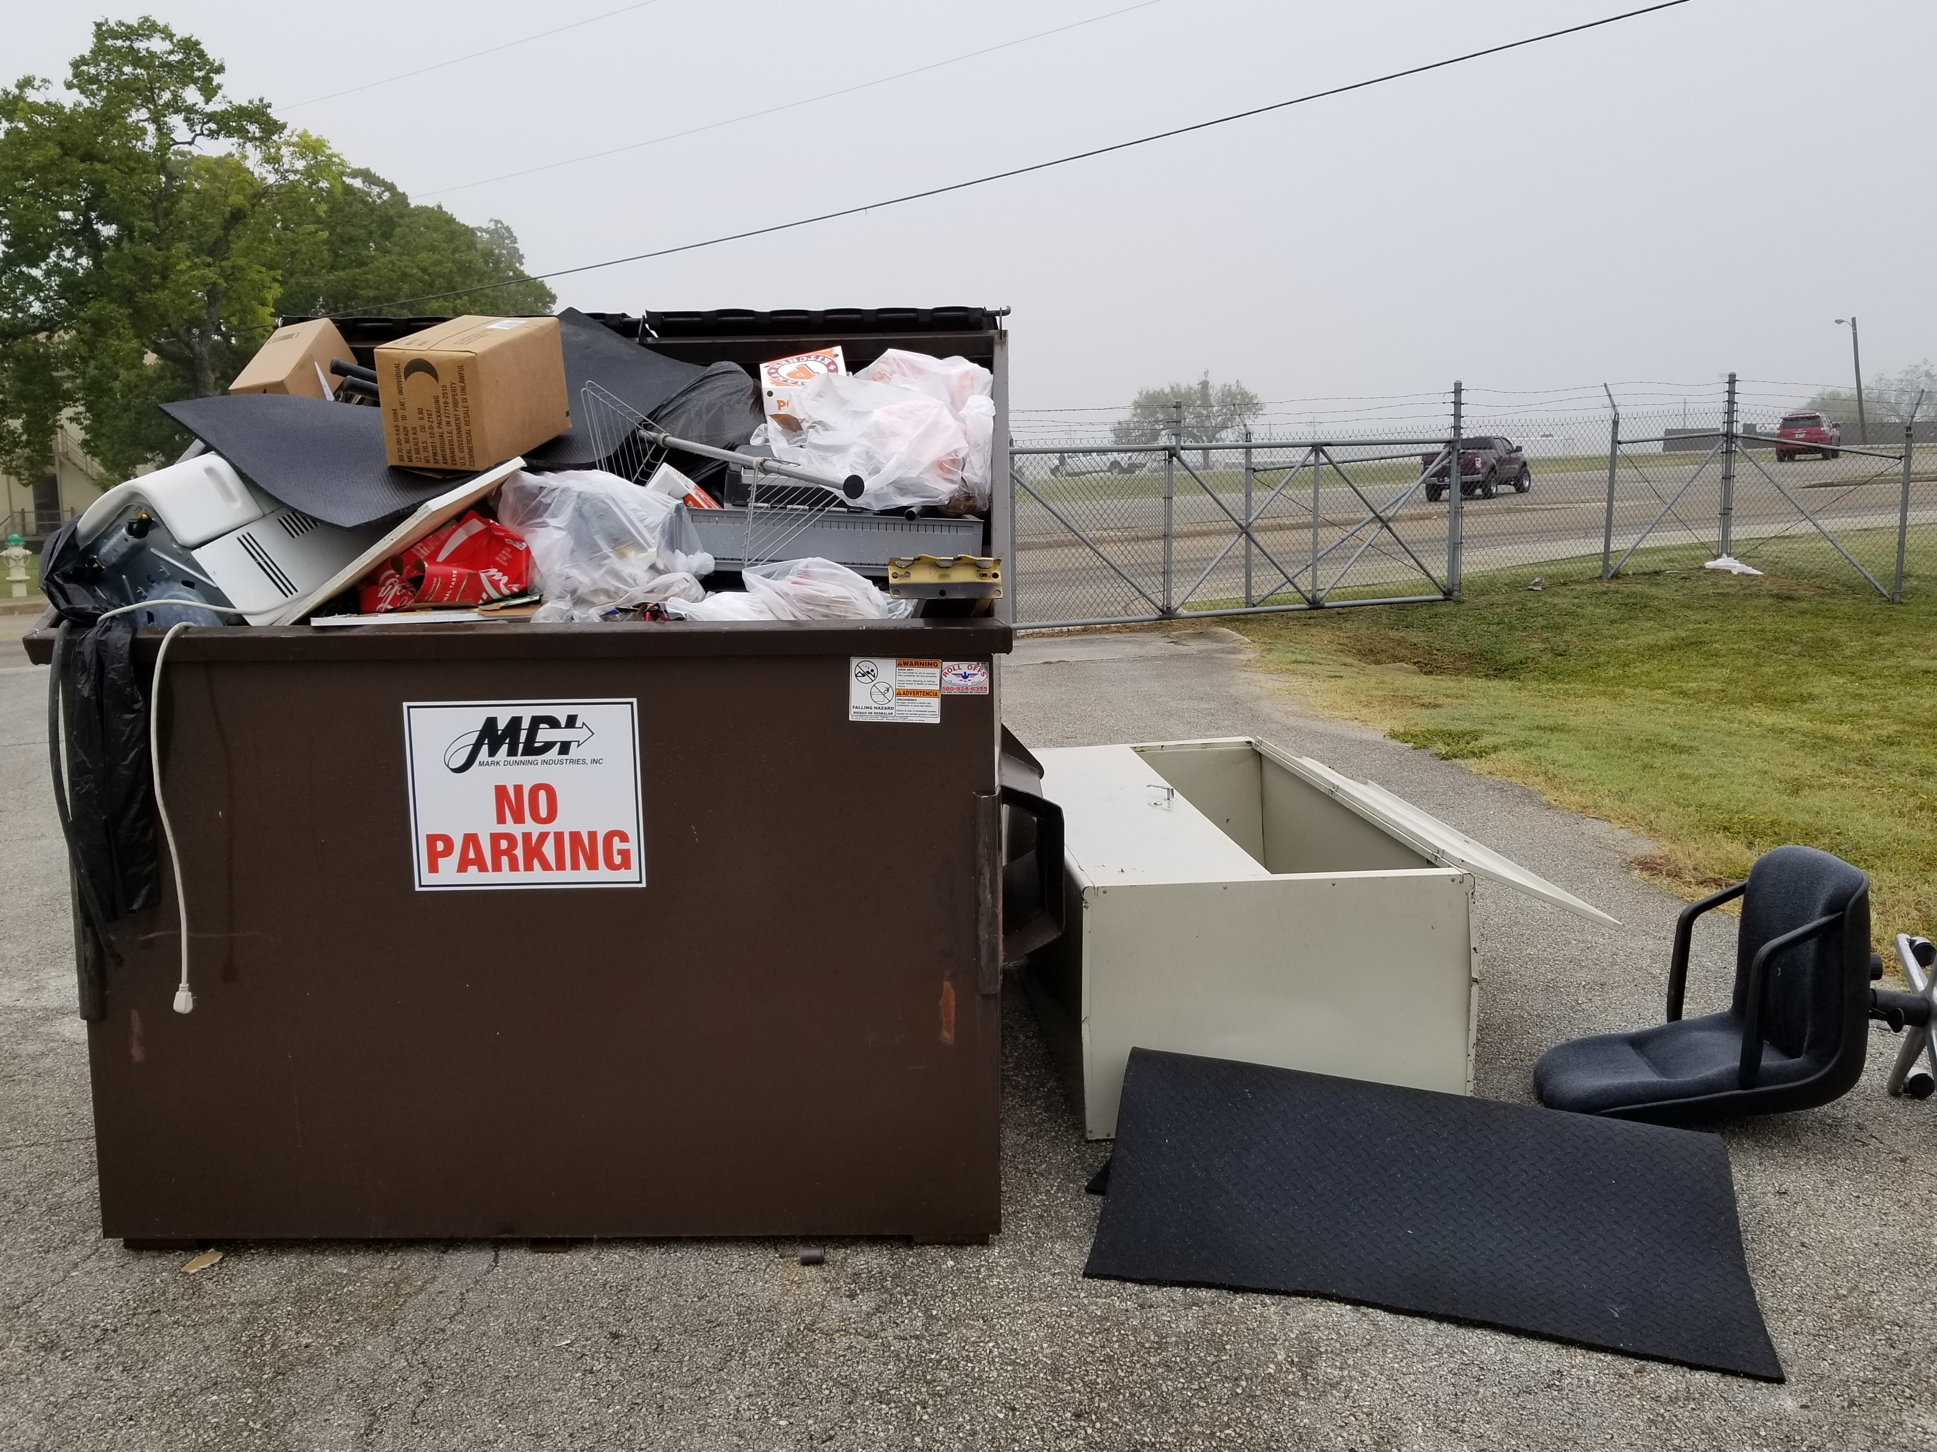
Furniture, Cardboard, Appliances, and Electronics
ARE NOT ALLOWED IN OR NEAR
Government Disposal Containers at JBSA.
Contact 502 CES Service Contracts or
your Recycle Center for proper disposal information.

